Slide 1

City of minnetonka
2025 Proposed Budget presentation
nov. 4, 2024

Slide 2
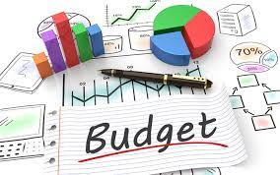
2025 Budget timeline year-to-date
Budget Timeline
  March 18 – Director presentations
  May 13 – 2025 budget kick-off session
  May 13 – Community Survey
  June 10 – CIP study session
  August 19 – Operating budget study session
  September 23 – Preliminary levy and budget adopted
  November 4 – Operation budget study session
    Review of draft budget by fund and department
    Review enterprise fund budgets and fees
  December 2 – Budget public hearing and adoption of final budget and levy
  December 23 – Alternate budget approval date

Slide 3

Property Taxes
Projected Property Taxes 7.23%
Operations 7.23%
General Operations 4.98%
Public Safety Plan 2.25%
Capital – CIP 0.00%
Debt
Comm. Facility Improv. 0.00%
*1% levy increase = $514,000
Taxes
Capital (CIP)
Debt
Operations

Slide 4
Levy Forecast

Slide 5
What’s in the budget – what does it represent
Second year of a multi-year program to implement the public safety master plan
  10 public safety related positions funded through the General Fund
Other new positions
  One DEI specialist funded through the General Fund
  3 Non-General Fund personnel requests
Second year of non-union class and compensation study implementation
Workers’ Compensation insurance increase. 20% increase for 2025, amounting to over $200,000
    Increasing classification rates based off of state-wide experience rating
    Increasing mod factor based off of city’s loss rate. Mod factor increasing from 0.69 to 0.87
    $89,000 decrease noted at the Oct. 28 council meeting is not reducing the levy
      Savings are directed towards fund balance within the Insurance Internal Service Fund to be used for deductibles, settlements and future premiums
Notes:
Fund balance is approx. $3 million.
ISF broke even in 2023
Not just workers comp but general liability insurance as well.
$300,000 in settlements in 2023

Slide 6
What’s in the budget – Non-Personnel Adjustments
Non-personnel budget adjustments
Adds include:
  $100,000 for increased software subscription licensing costs,
  $100,000 for increased electricity costs due to Xcel Energy and PUC changing the reimbursement factor for CSG,
  $100,000 for city zoning rewrite project,
  $40,000 for replacement permitting software application.
Reductions include:
  Sharing of State Fire Aid with the Minnetonka Fire Relief Association, saving the city $260,000,
  Eliminating the planned $250,000 operating subsidy for The Marsh,
  $60,000 savings from halting the ERP/HCM implementation project,
  $50,000 in fuel savings, mostly attributed to more efficient vehicles and indoor parking for squad cars,
  $50,000 in salt inventory due to better yearend inventory control.

Slide 7
2025 proposed General Fund Budget
Notes:
Modified page 14

Slide 8
PROPERTY TAXES SUPPORT BASIC SERVICES – General Fund

Slide 9
2025 proposed General Fund Budget

Slide 10
Homeowner impacts
Median valued home increasing in value 1.15% to $502,200 will see an annual tax increase of $148 (8.60%)
25th Percentile home increasing in value 1.15% to $415,900 will see an annual tax increase of $94 (6.62%)
75th percentile home increasing in value 1.15% to 660,250 will see an annual tax increase of $201 (8.91%)

Slide 11
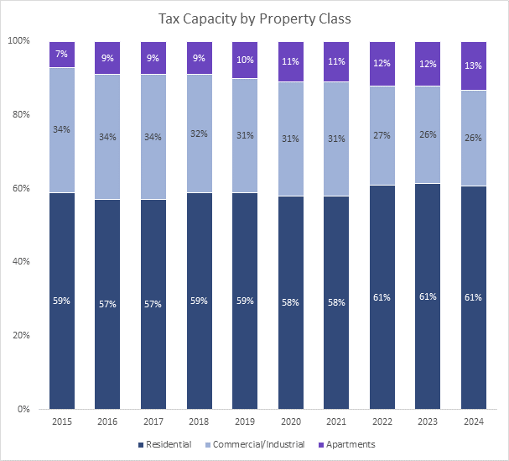
Homeowner impacts

Slide 12
2025 Preliminary tax increases (Subject to change)
Notes:
Average increase is 9.17%
Median increase is 8.30%

Slide 13
Future project considerations
  Fire station remodeling to accommodate 24/7 staffing
  Opus Park improvements
  Street & utility infrastructure needs
  Community facility improvements

Slide 14
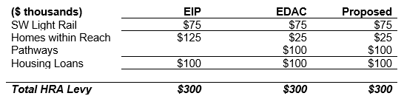
Hra levy
City’s first HRA levy began in 2009
State law limits levies to a max rate of 0.0185% of city’s taxable market value
  Approximately $2.3 million for 2025
  EIP recommends the 2025 HRA levy remain constant at $300,000
  EDAC recommends reallocation of the $300,000 as follows:
    EDAC/City Council will consider a request from HWR in 2025 if the fund balance is utilized or if there is a change in housing type, ie: single household to duplex

Slide 15
2025 Budget Communication & Feedback
Minnetonka always encourages input on its budget from the public
Regular communication through the Minnetonka Memo
City-wide emails
Minnetonka Matters is being utilized to communicate budget information and solicit feedback
  432 site visits
  16 comments
Staff share all comments received with the council
Truth-in-Taxation notices mailed by the county beginning Nov. 12
Reminder: official opportunity for the public to provide feedback on the tax levy and the budget will be on Monday, Dec. 4 at 6:30 p.m.

Slide 16
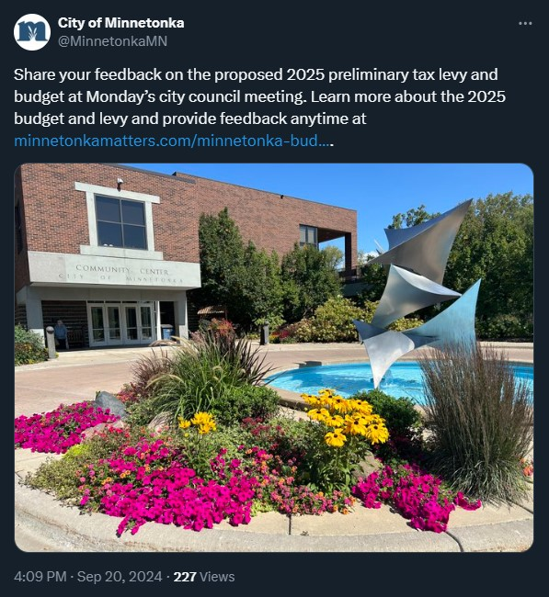
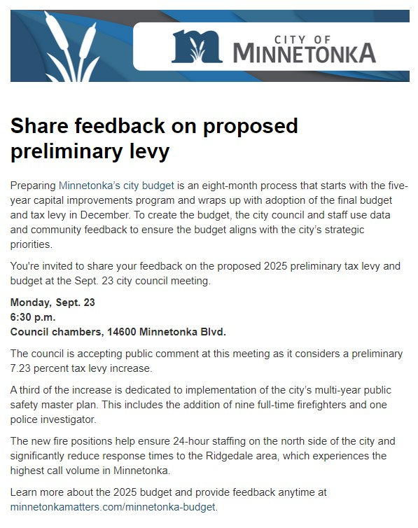
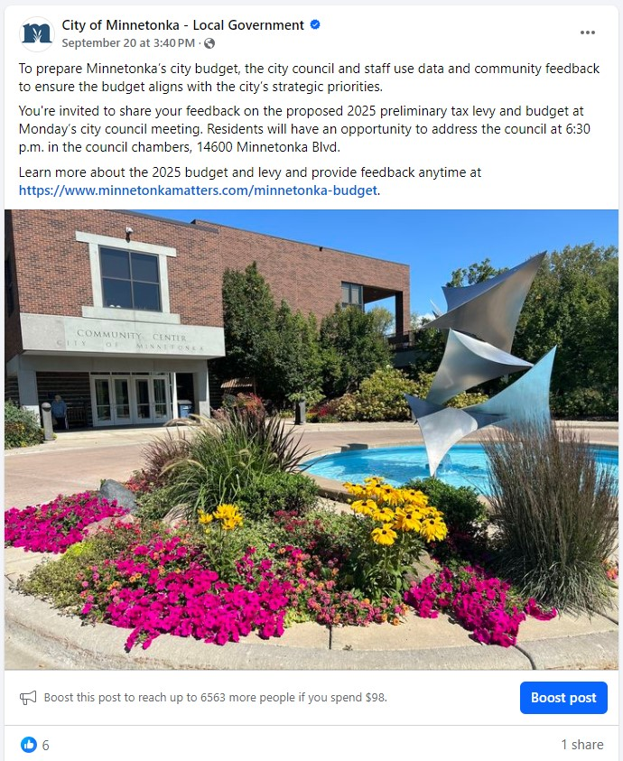
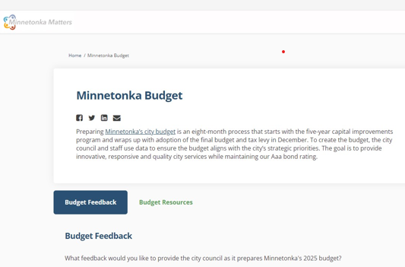
Communication

Slide 17
Discussion QUestions
Does the city council agree to proceed to the Dec. 2, 2024 regular council meeting with the proposed general levy of $55,124,693, representing a 7.23% overall increase? (4.98% operation + 2.25% for public safety)?
Does the city council agree to proceed to the Dec. 2, 2024 regular council meeting with the proposed EDAC’s levy of $300,000?

Slide 18
QUESTIONS?

